Slide 1
Society Online
Echo Software Consultancy Services
Society Administrator can maintain various data, generate Bill / Receipt , Assign Password to members, Check / update complaint , Vehicle information , Item information , Visitor record , Check member balance amount, Received - Expenditure Details using website. Information Email Can be send to all members , Bill can be Emailed in .pdf form.

Slide 2
Society Online
Echo Software Consultancy Services
Members can check Members List, Vehicle details , Visitor details, Bills , Receipt , Information posted my Manager , Important Phone Nos , Download documents uploaded by Manager , Post Complaints , Check complaints status , Post important Phone numbers usuful for all society members using Android Application or Website , So Manager need not to send Bill / Receipt to members.

Slide 3
Society Online
Echo Software Consultancy Services
Security : 1. Visitor Record (With Photo) : Using Android App , security personnel can enter visitor data, owner will receive SMS during entry. 2. Swimming pool / Club House authorisation : Manager can authorise personnel to enter pool / club house.

Slide 4
Society Online
Echo Software Consultancy Services
QR Code : QR Code can be generated by Society Admin. Visitor can scan QR Code to enter own data. Concerned member can check the visitor details

Slide 5
Society Online
Echo Software Consultancy Services
Android App :
1. For Society Manager (To authorize members to enter in Pool / Club House).
2. For Members (check Members List, Vehicle details , Visitor details, Bills , Receipt , Information posted by Manager , Important Phone Nos , Download documents uploaded by Manager , Post Complaints , Check complaints status , Post important Phone numbers useful for all society members).
3. For Security Staff to upload visitor information.
4. For Pool / Club house to check authorization.

Slide 6
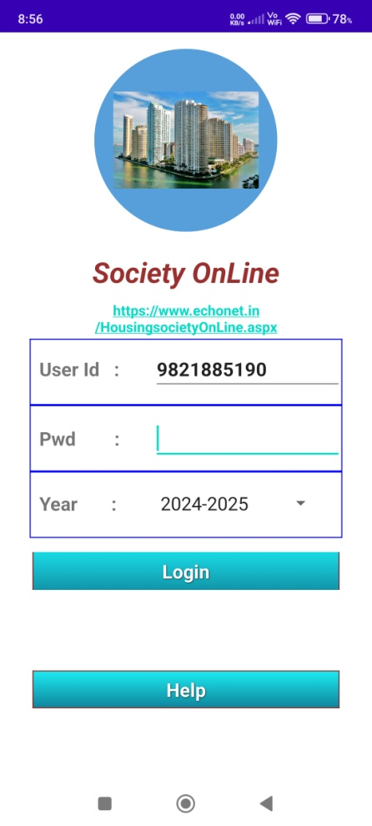
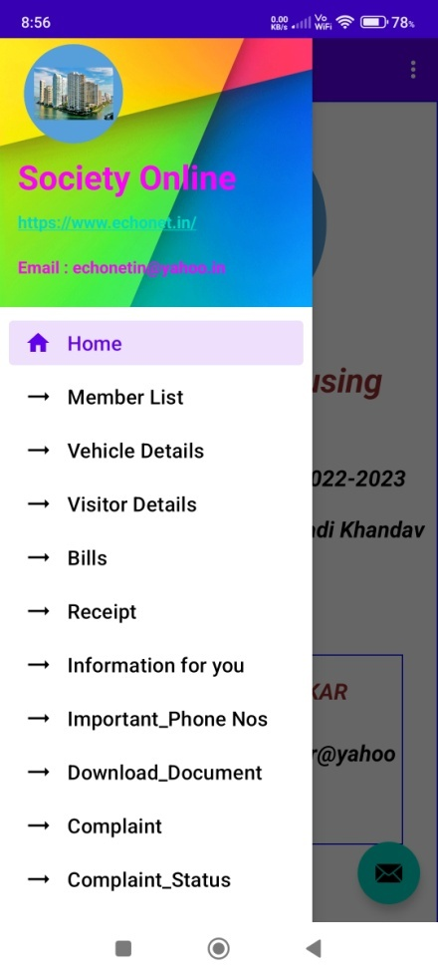
Society Online
Echo Software Consultancy Services
Android App :

Slide 7
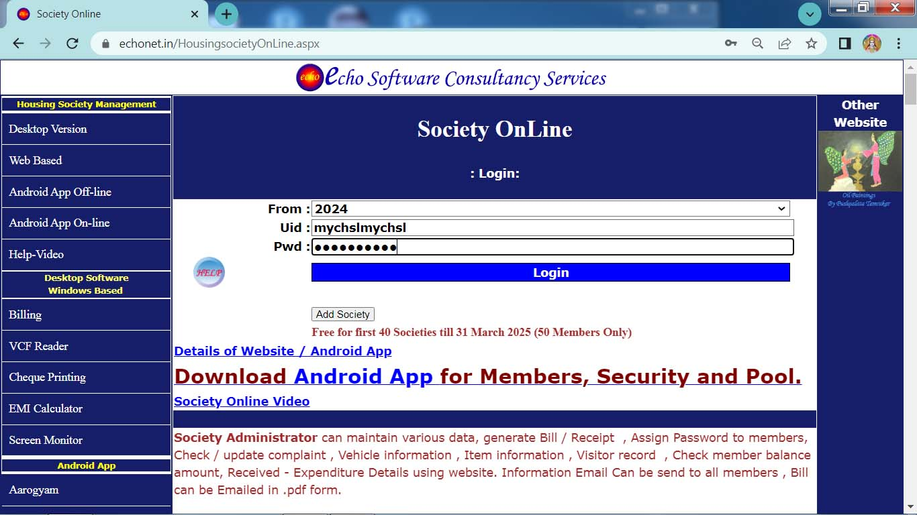
Login (Website)

Slide 8
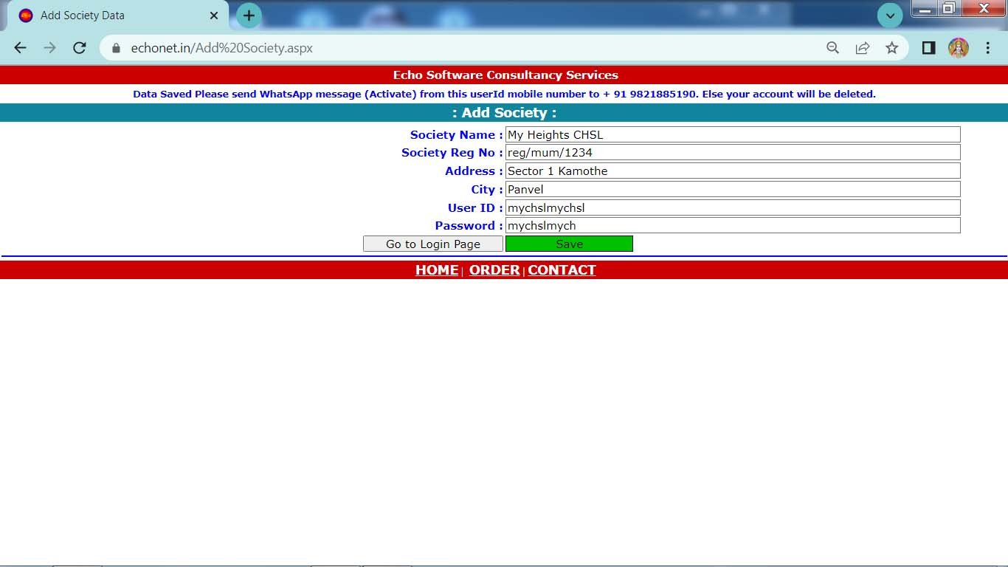
Add Society

Slide 9
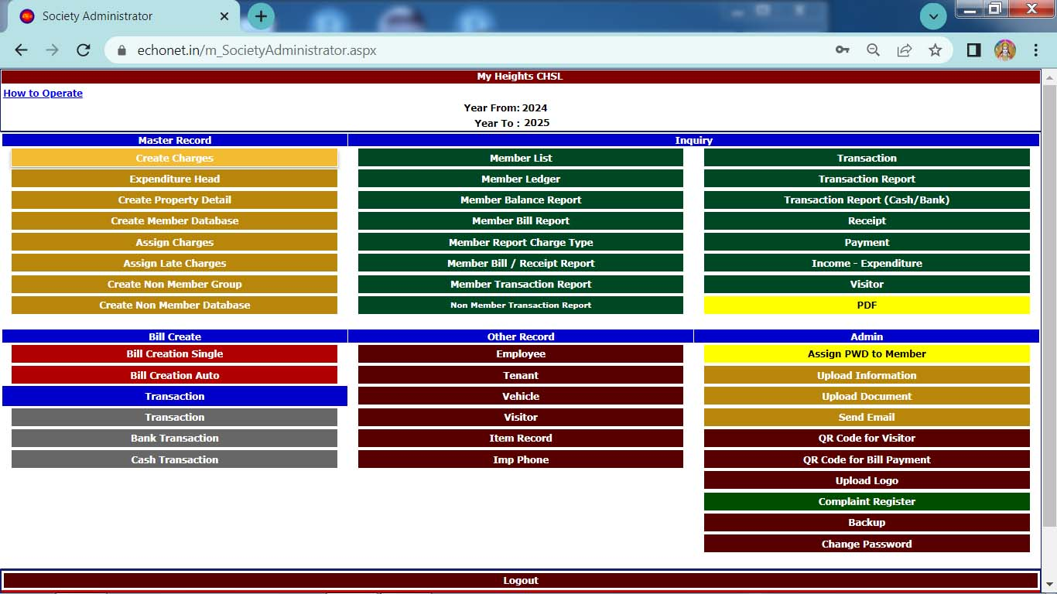
Main Menu
Add Master Record first , prior to make any Bill / Transaction.
Assign PWD to Member : So that Members can use Website / Android App

Slide 10
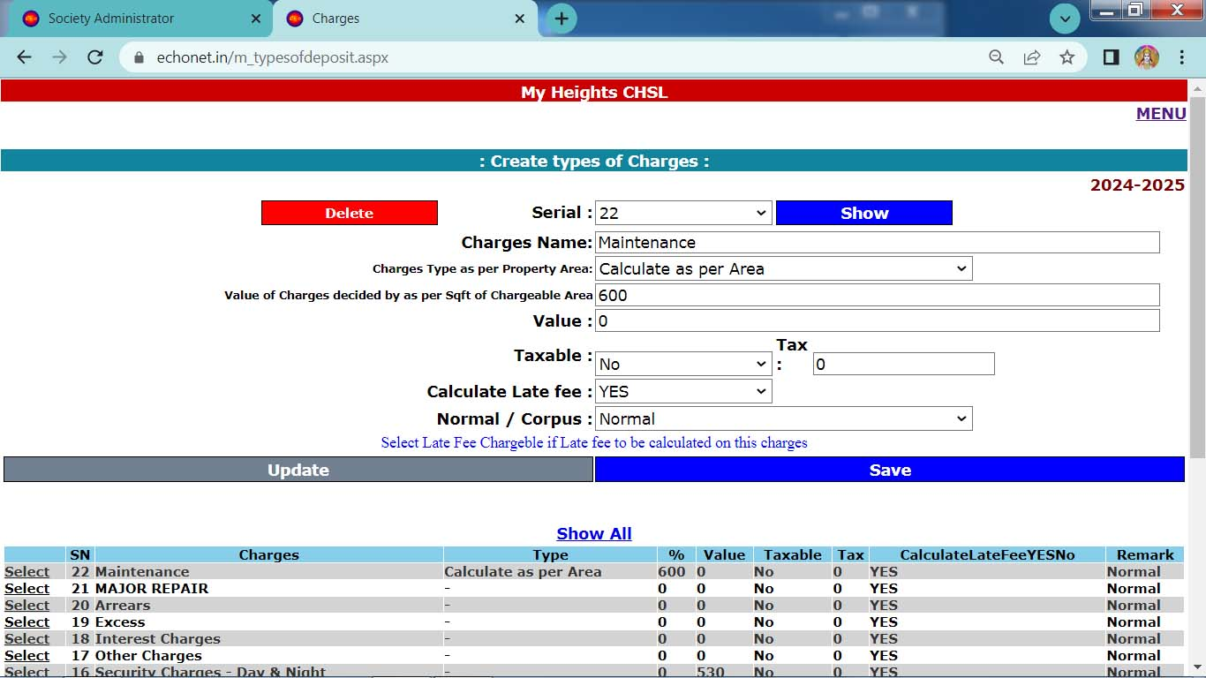
Create Charges
Create Charges as per Society need.

Slide 11
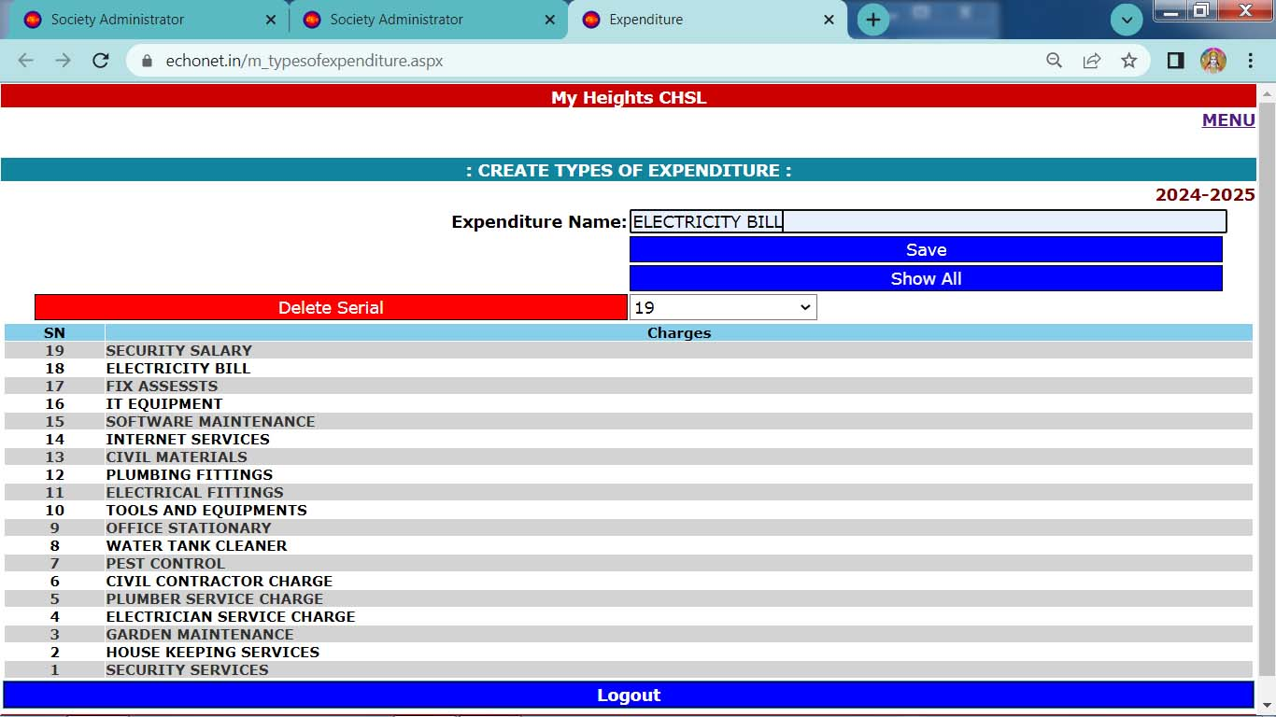
Create Expenditure
Create Expenditure Head.

Slide 12
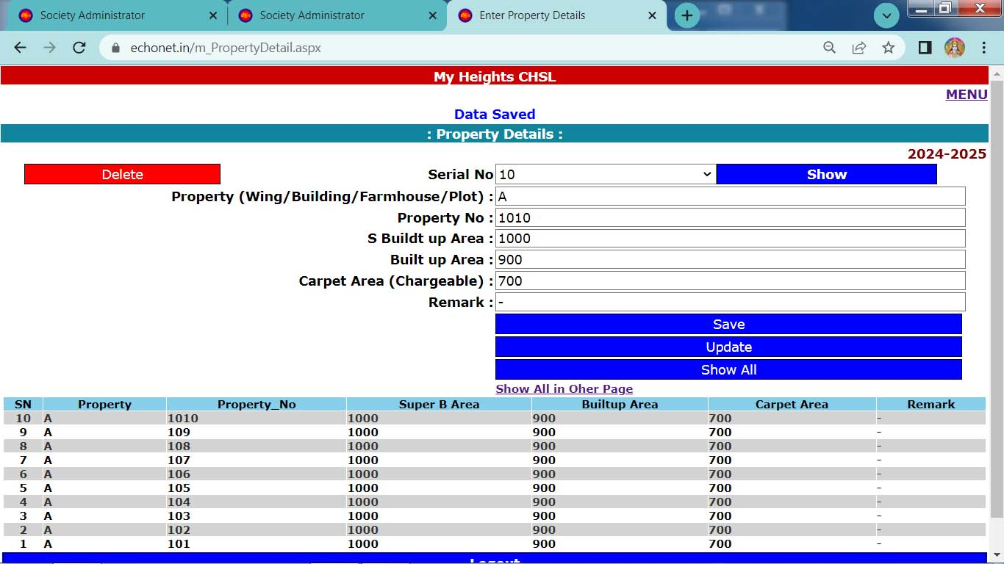
Create Property Details

Slide 13
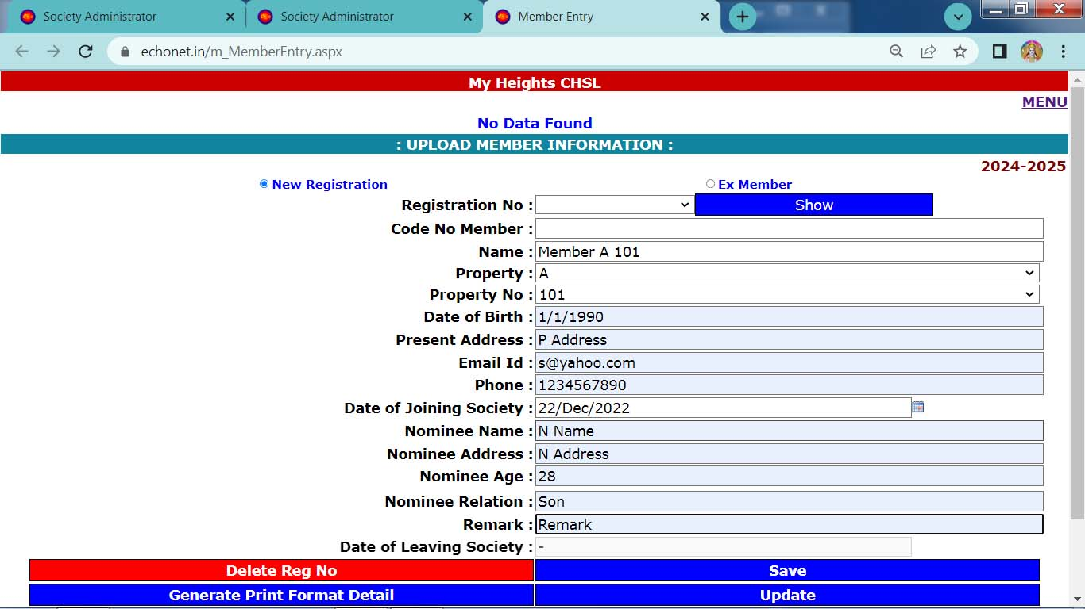
Create Members Database

Slide 14
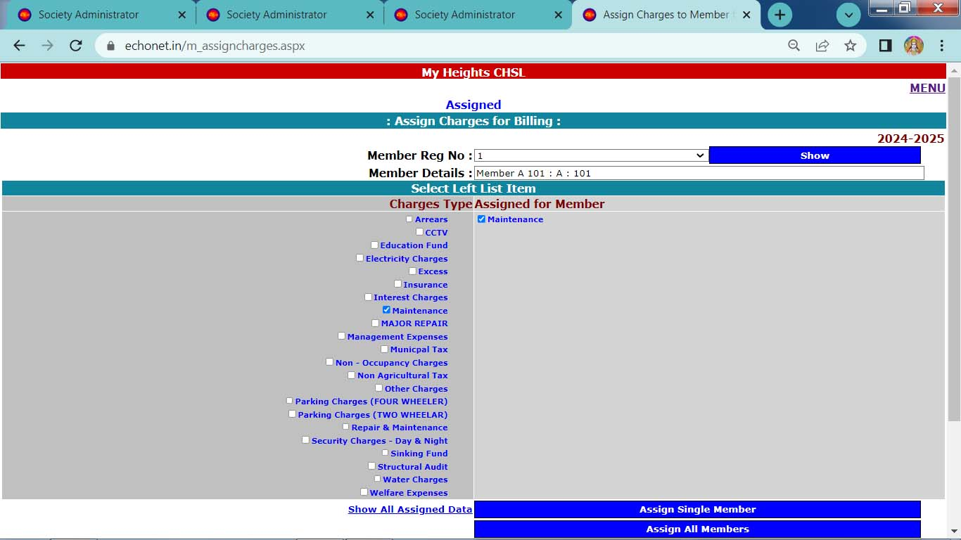
Assign Charges to Members (for Auto Bill Generation)
Assign Charges to all members , so that Bills for all members can be made with single click.

Slide 15
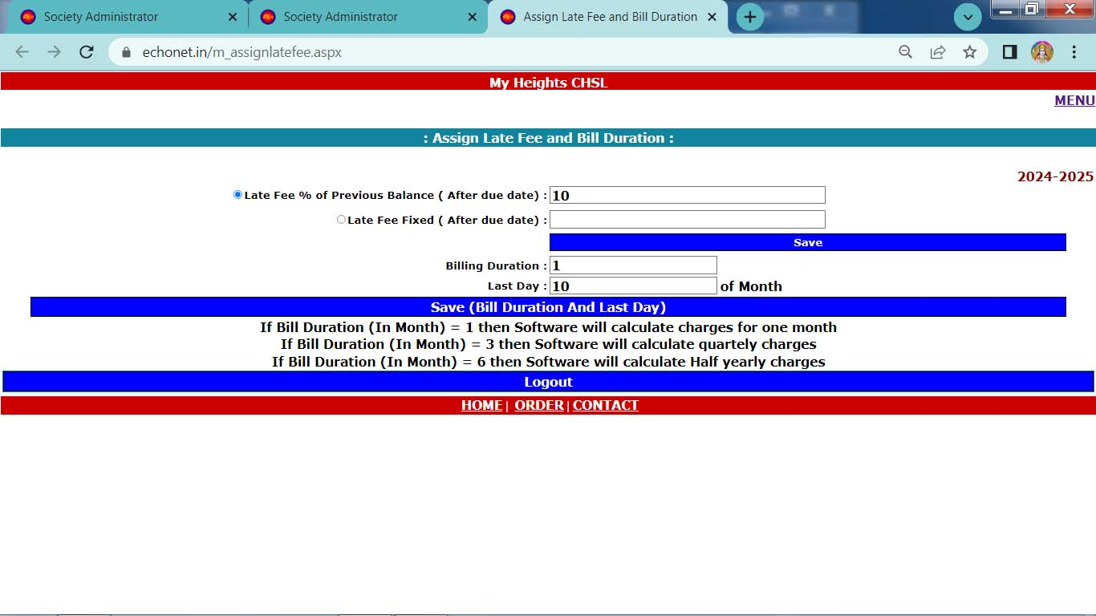
Assign Late fee and Bill Duration

Slide 16
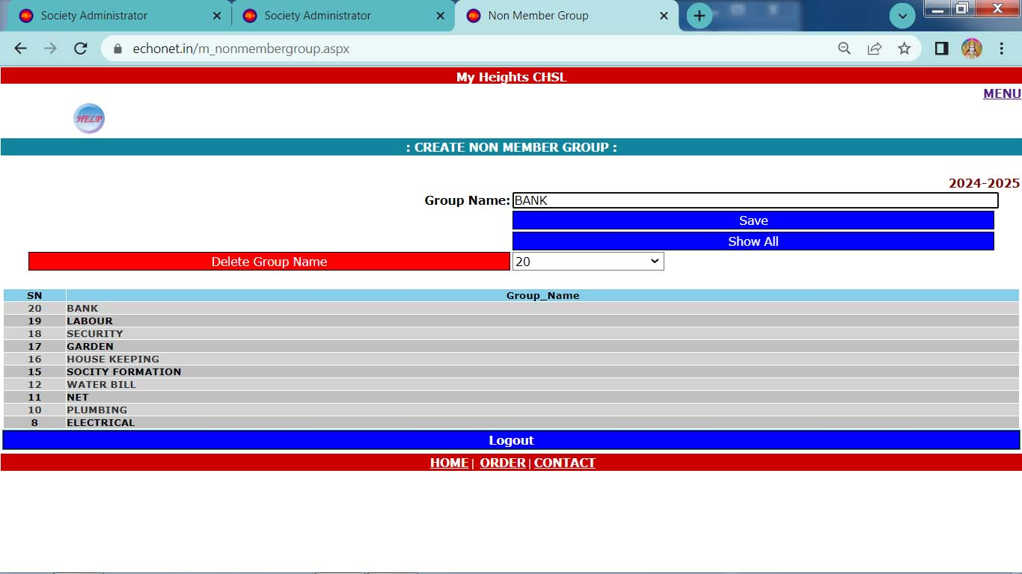
Create Non Member Group
Create Non Members group.

Slide 17
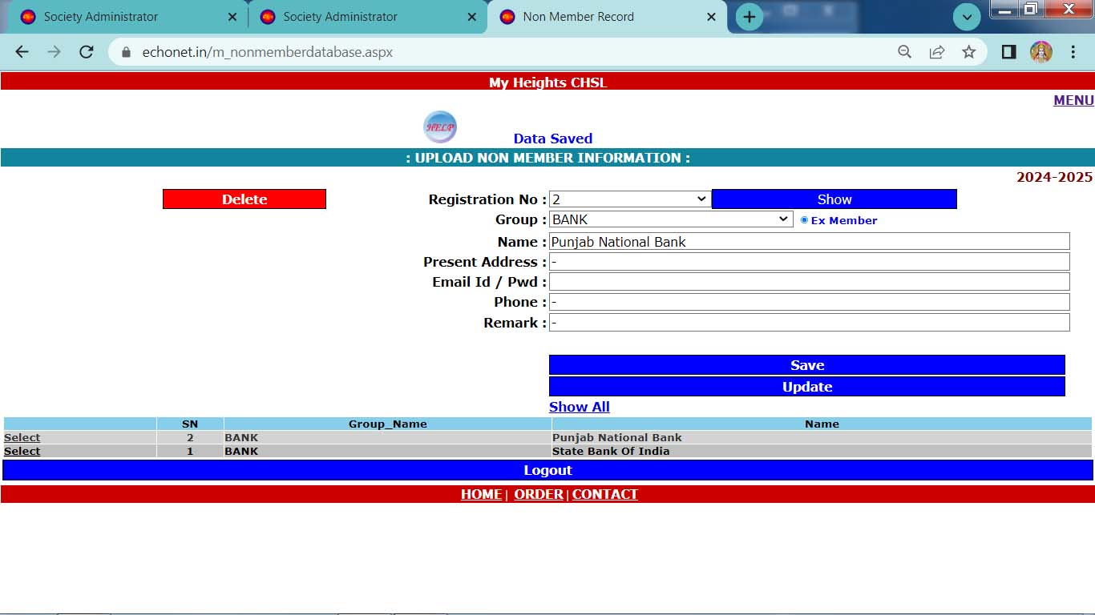
Create Non Member’s Database
Create Non Members database as per Non Member group.

Slide 18
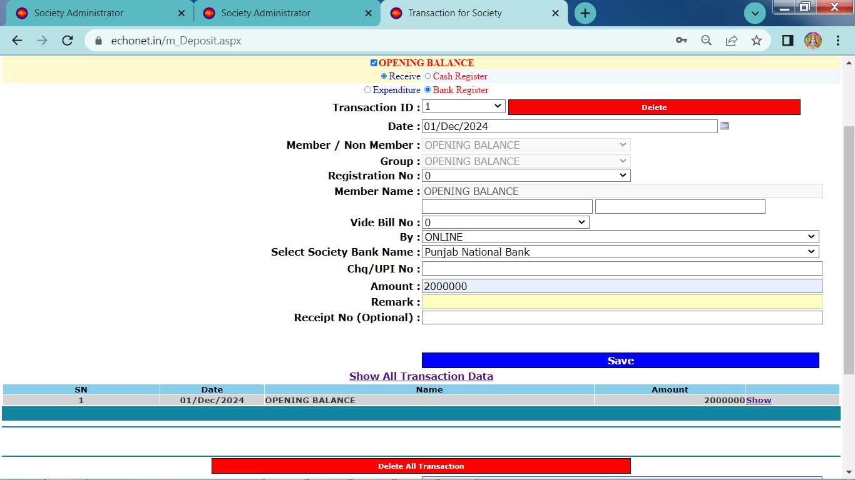
Insert Opening Balance (Bank)
Initially opening balance to be inserted into Bank account and Cash account.
Select Receive → Bank or Cash Register prior to entry.

Slide 19
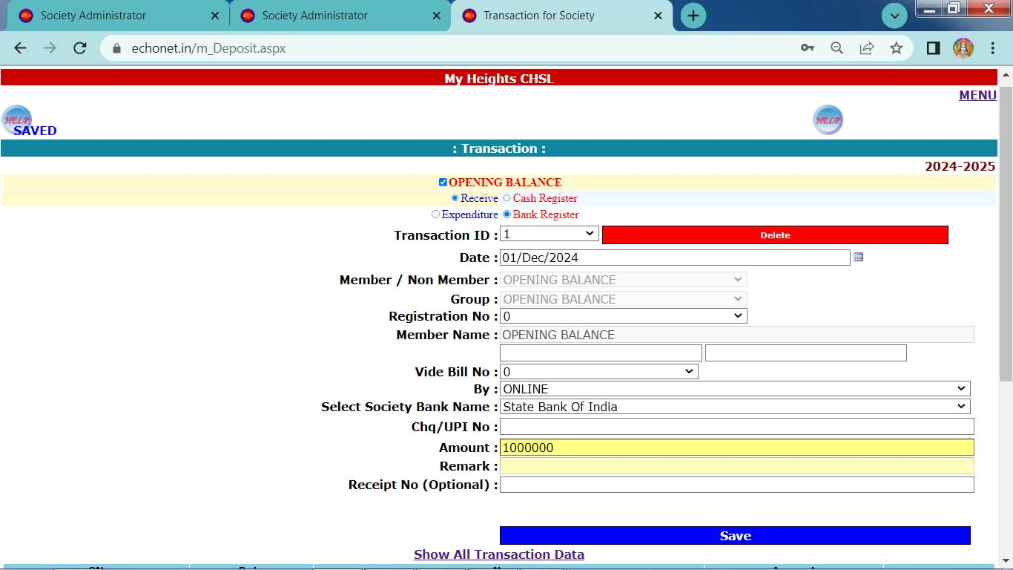
Insert Opening Balance (Bank)
Initially opening balance to be inserted into Bank account and Cash account.
Select Receive → Bank or Cash Register prior to entry.

Slide 20
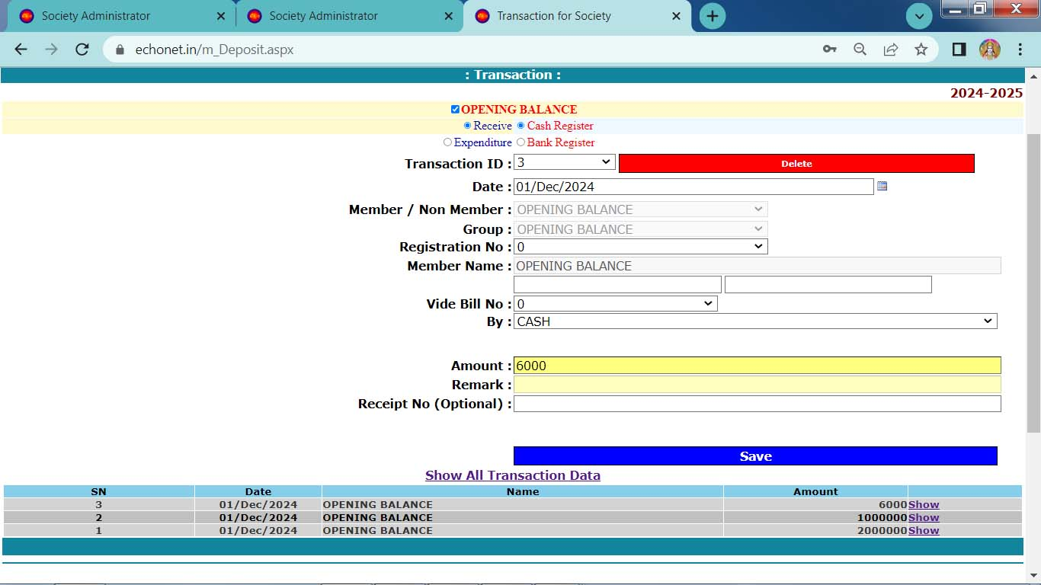
Insert Opening Balance (Cash)
Initially opening balance to be inserted into Bank account and Cash account.
Select Receive → Bank or Cash Register prior to entry.

Slide 21
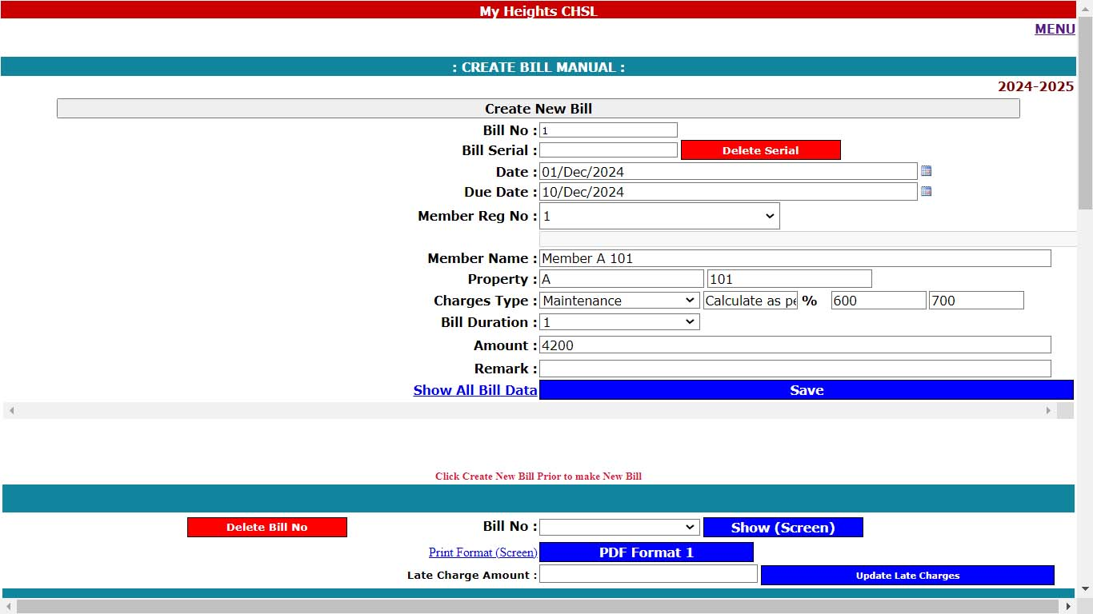
Create Bill Single
Click - Create New Bill , prior to make any Bill.
Select Member Reg No
Select Charges Type
Amount
Click Save
Repeat point 3 to 5 again for next entry.
After complete entry of present Bill , click - Create New Bill again.

Slide 22
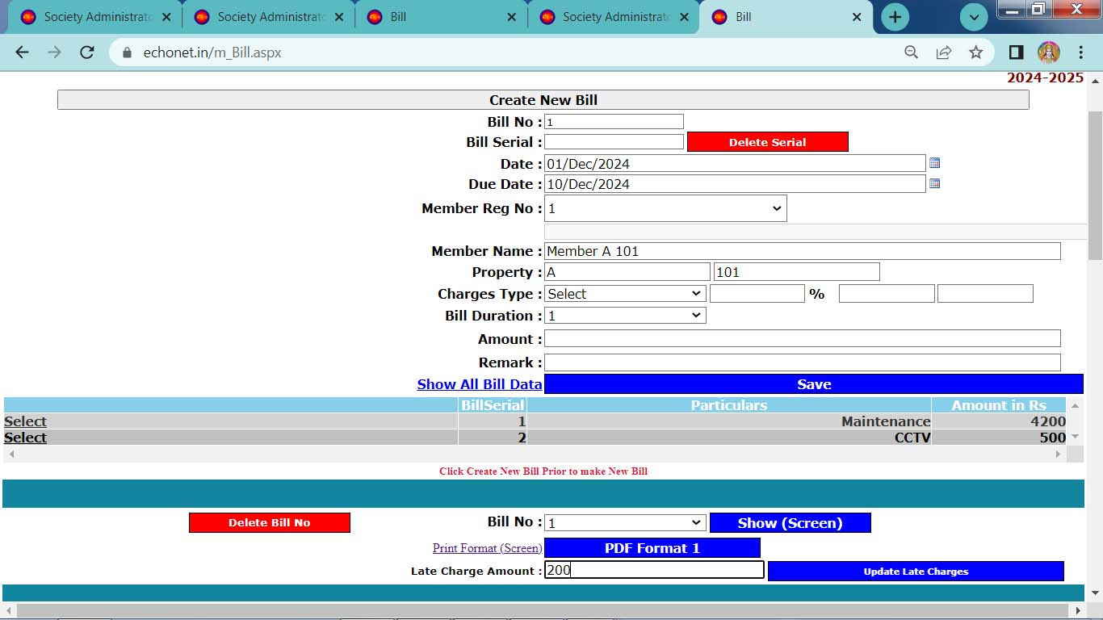
Create Bill Single

Slide 23
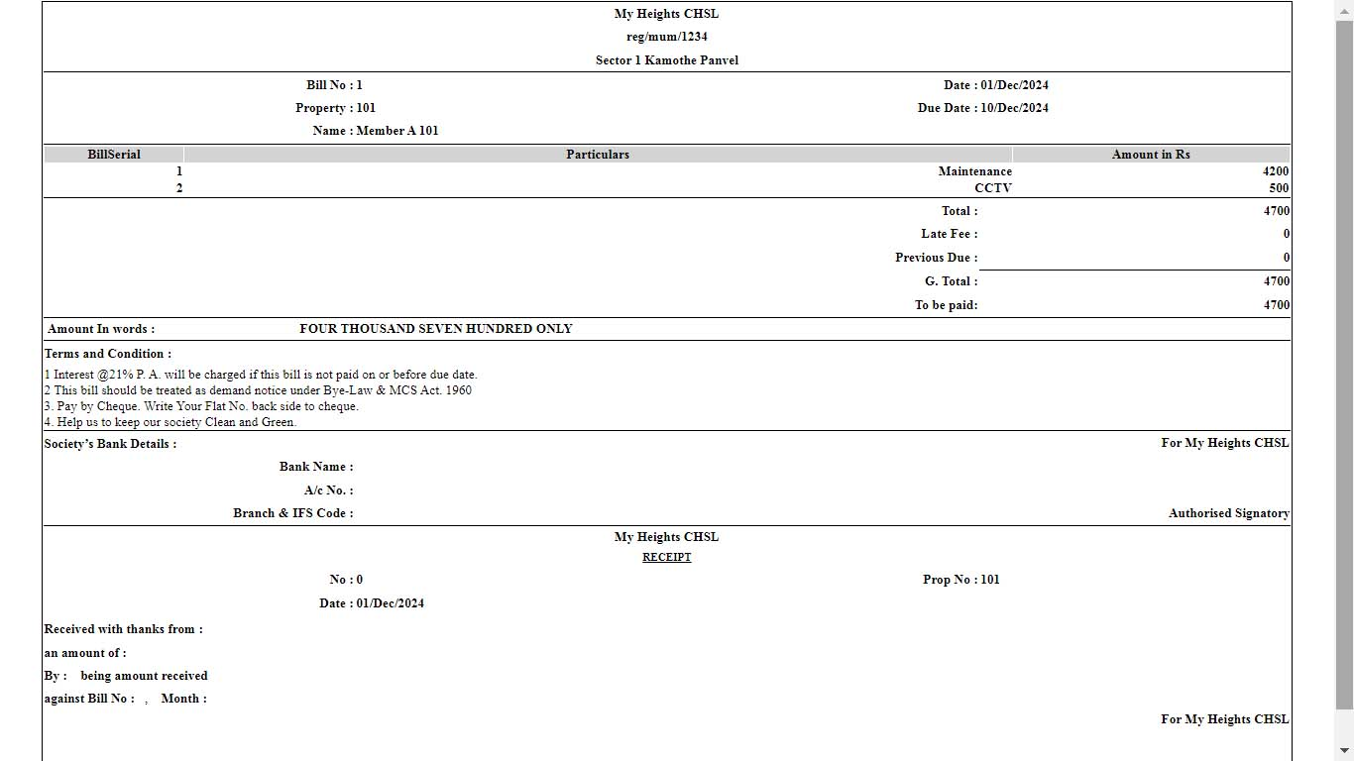
Bill format Generated online

Slide 24
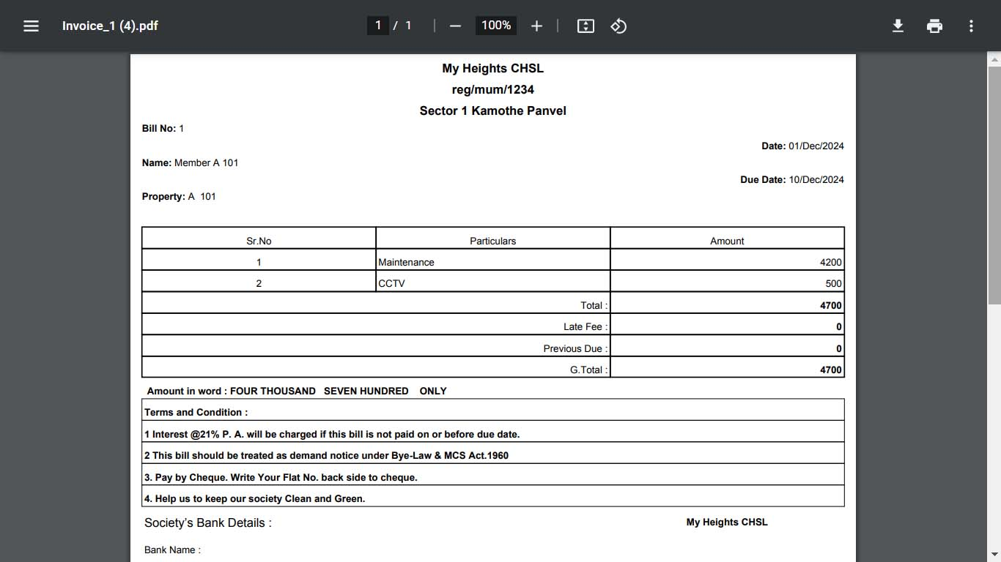
Bill format Generated Pdf format

Slide 25
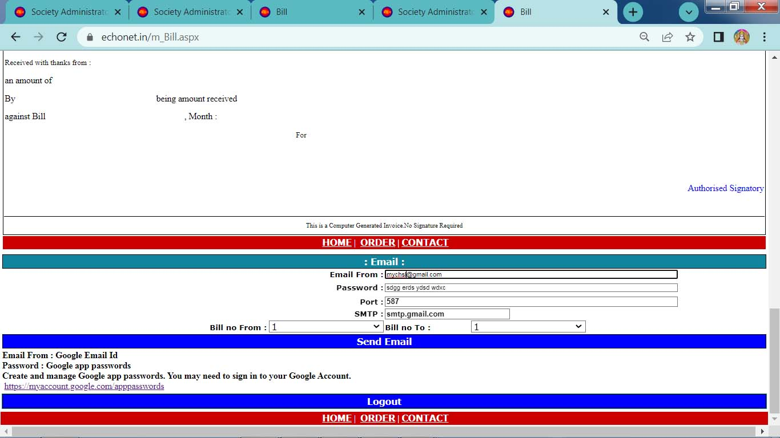
Bill can be Emailed to All members with single click

Slide 26
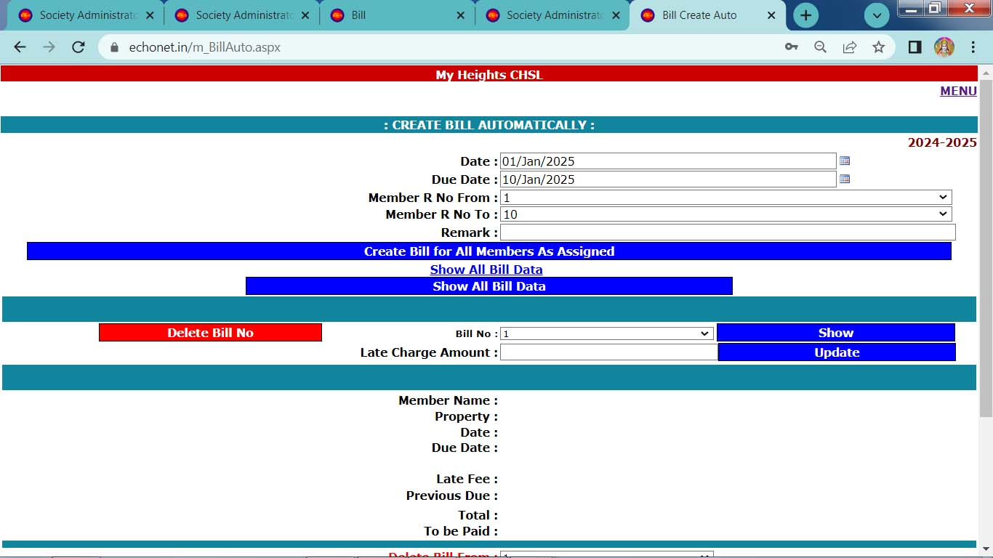
Create Bill to all members with single click (As charges assigned)

Slide 27
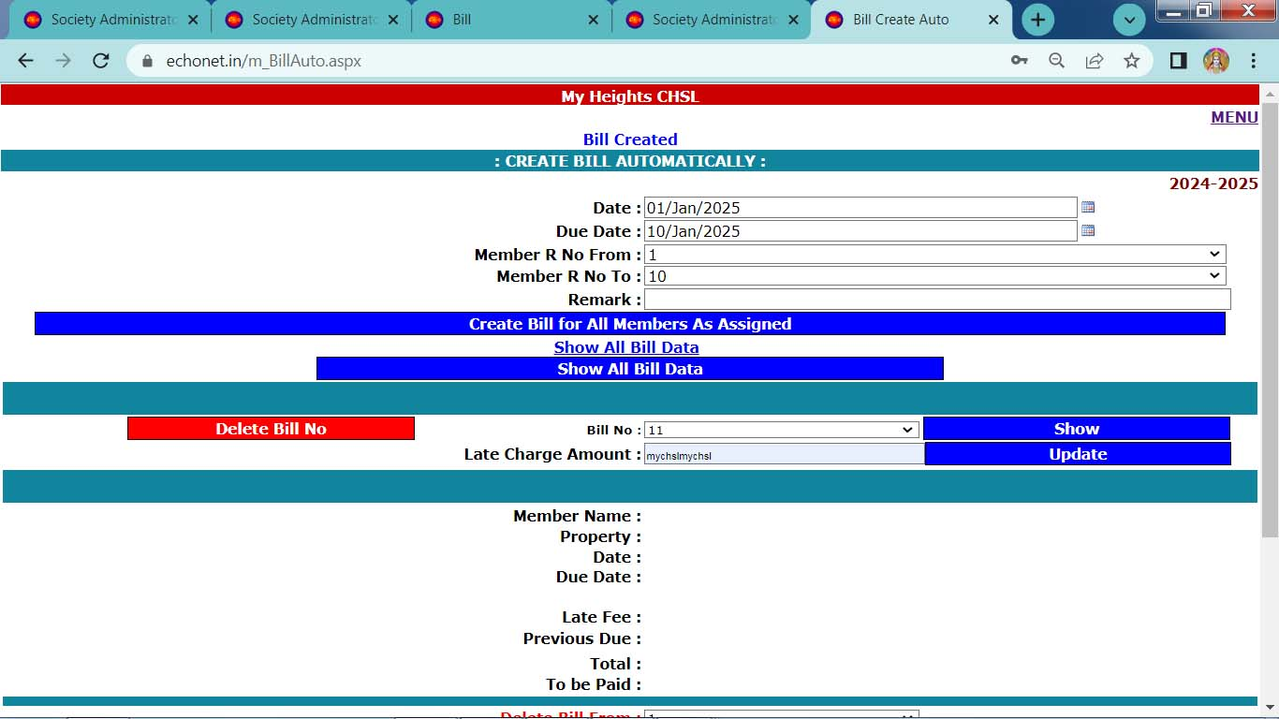
Create Bill to all members with single click (As charges assigned)

Slide 28
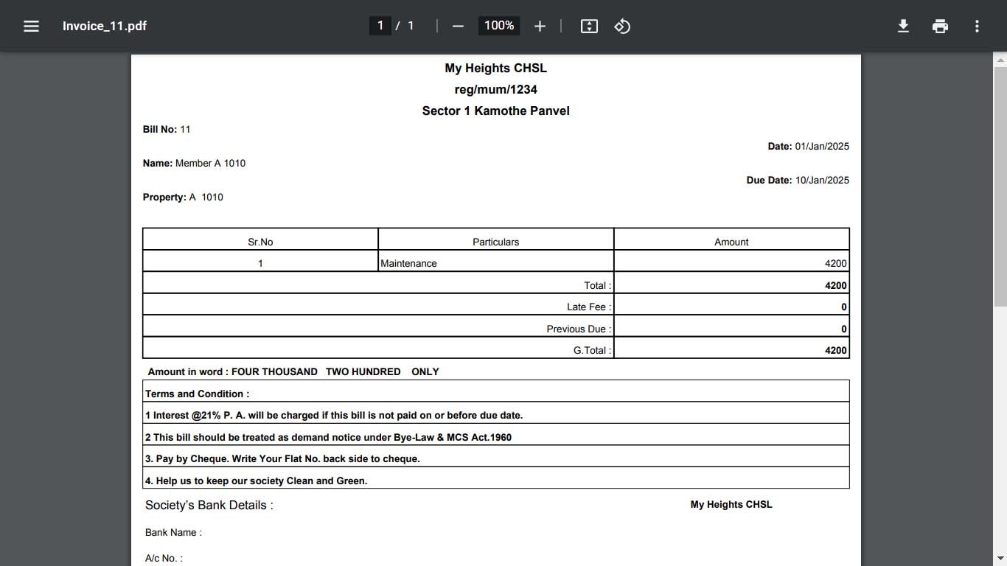
Bill in Pdf format

Slide 29
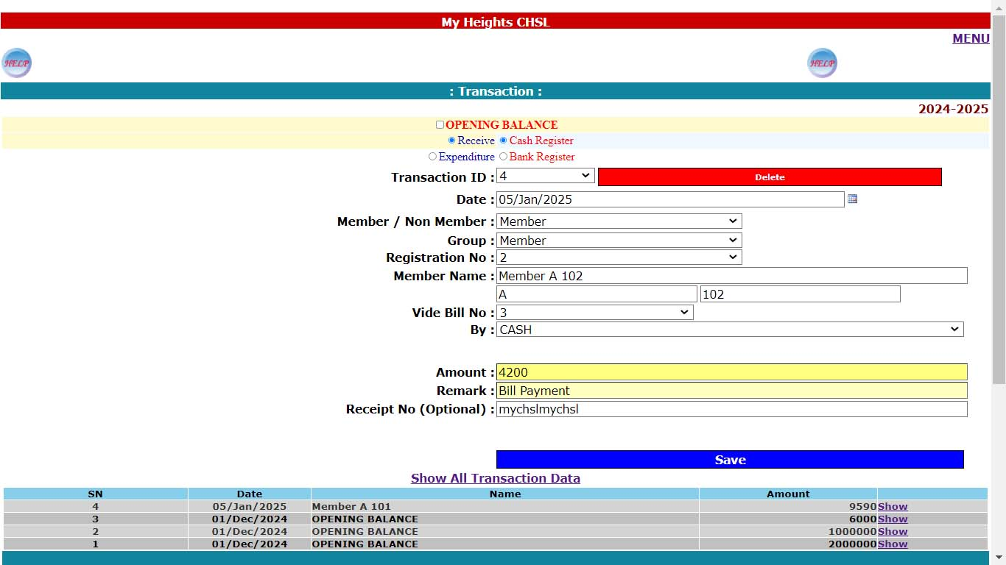
Transaction as Bill received

Slide 30
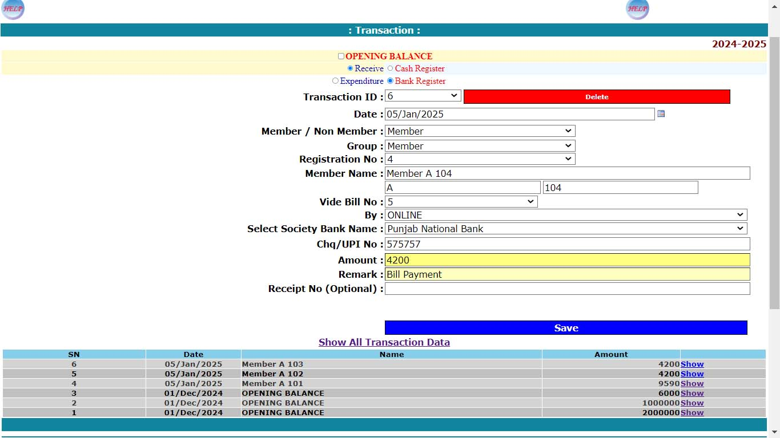
Transaction as Bill received

Slide 31
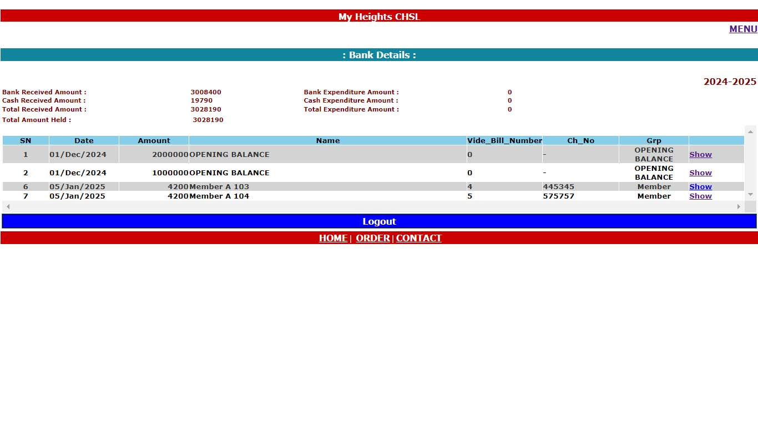
Bank Transaction report

Slide 32
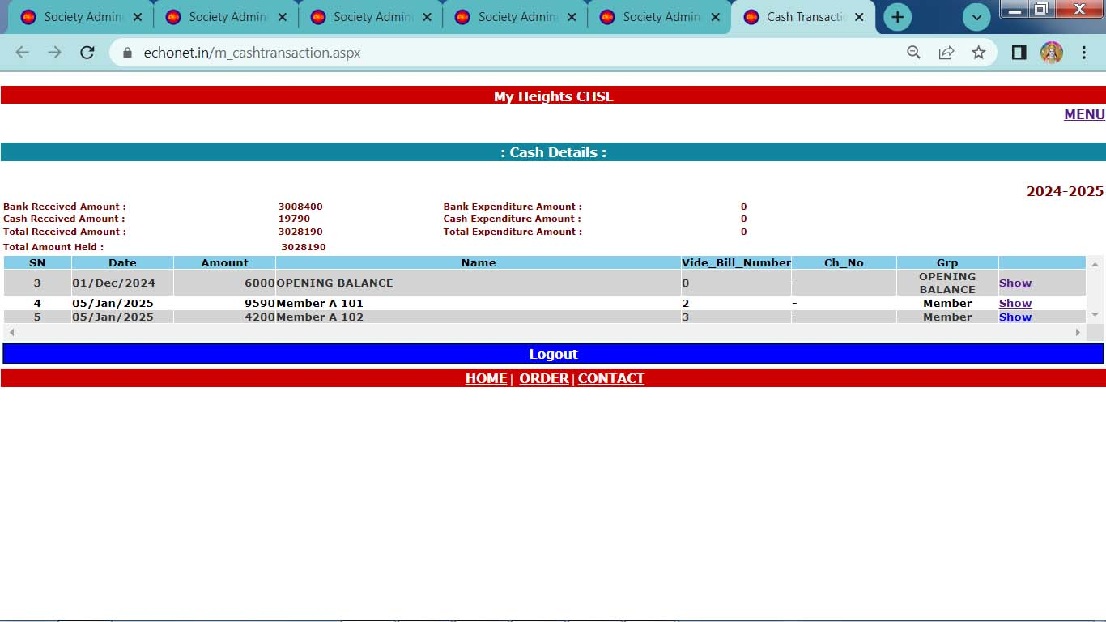
Cash Transaction report

Slide 33
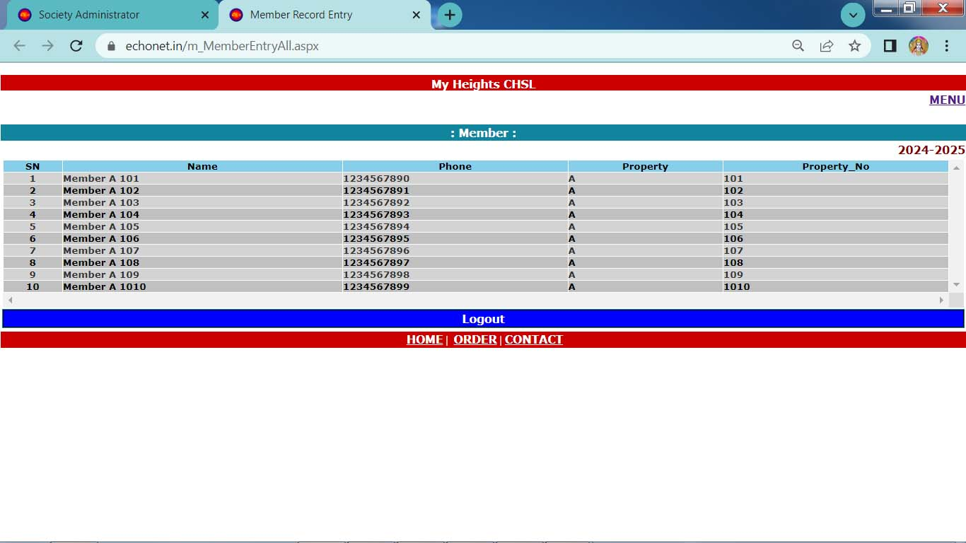
Member’s List

Slide 34
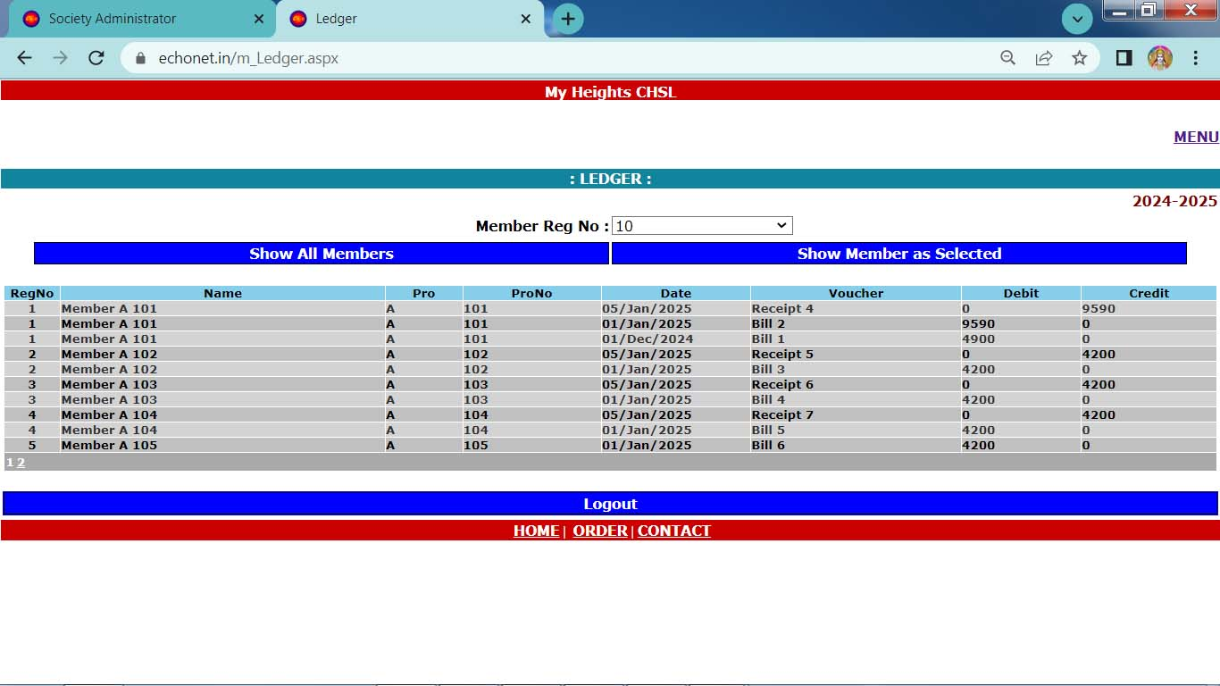
All Member Ledger

Slide 35
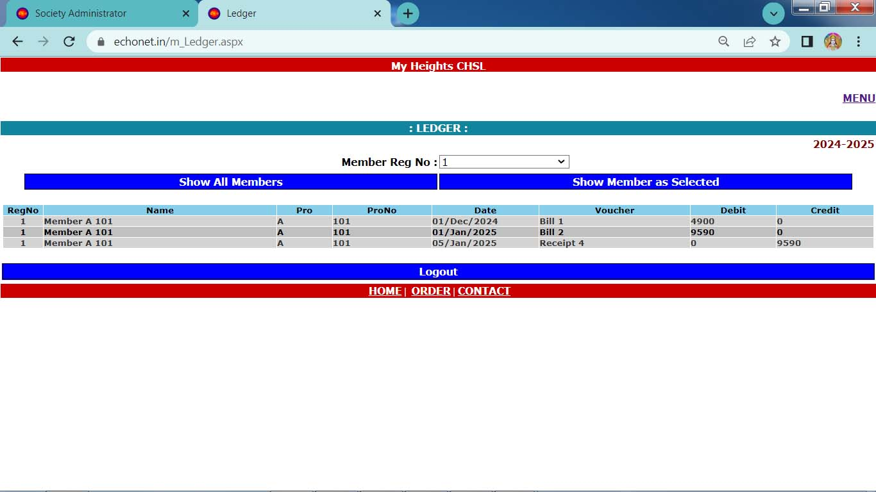
Single Member Ledger

Slide 36
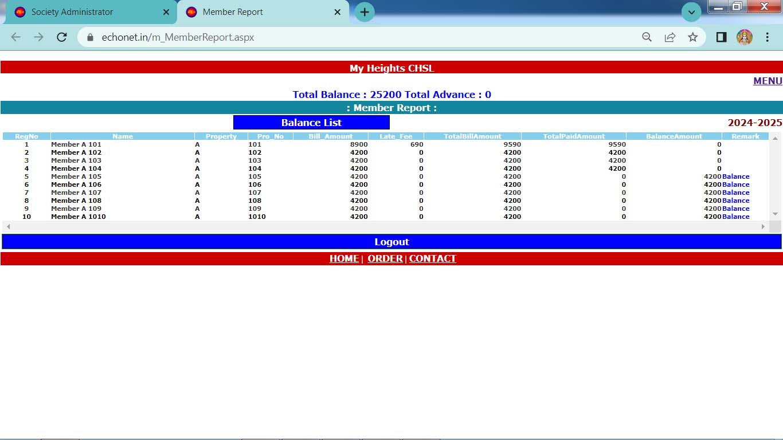
Member Balance Report

Slide 37
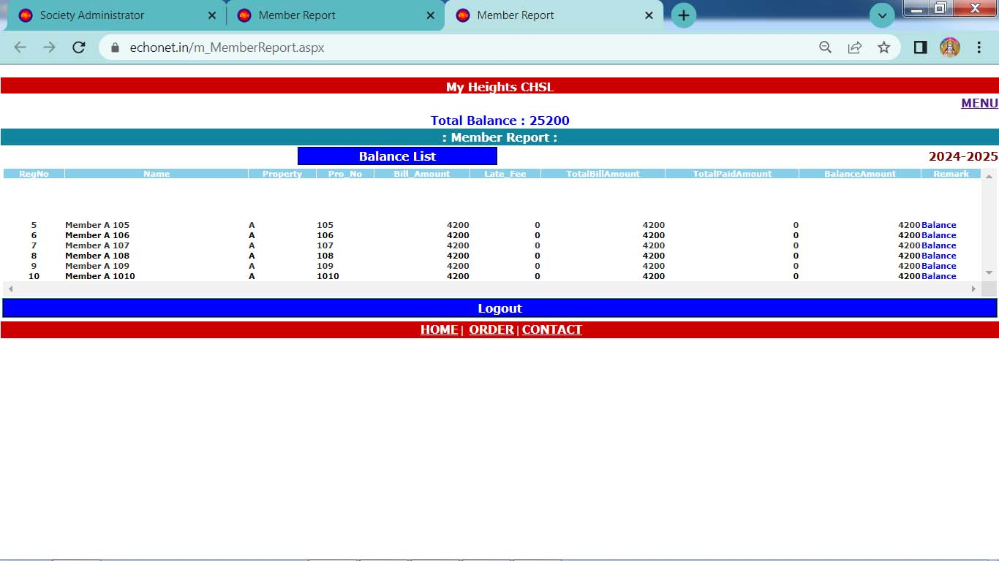
Member Defaulter Report

Slide 38
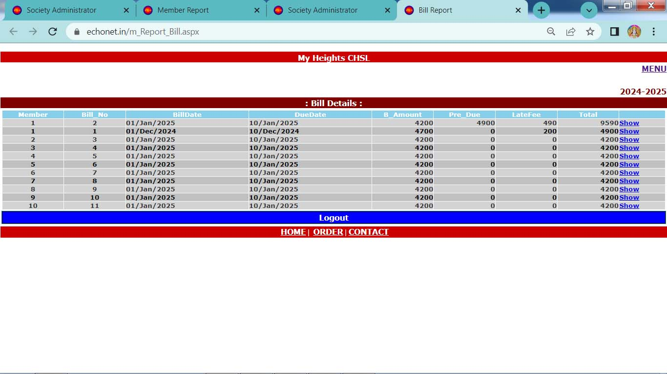
Bill Details

Slide 39
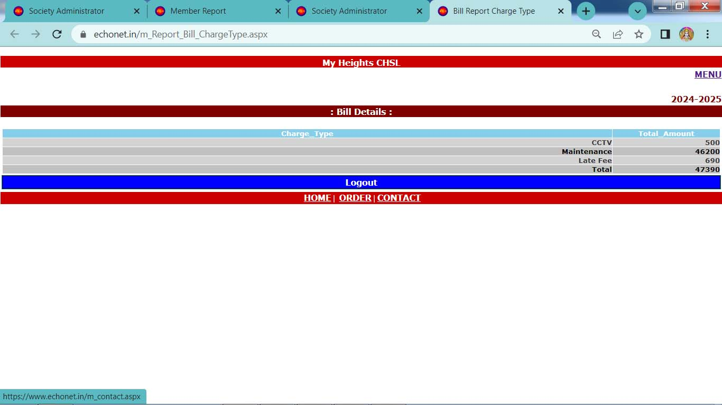
Received Amount as per Charges

Slide 40
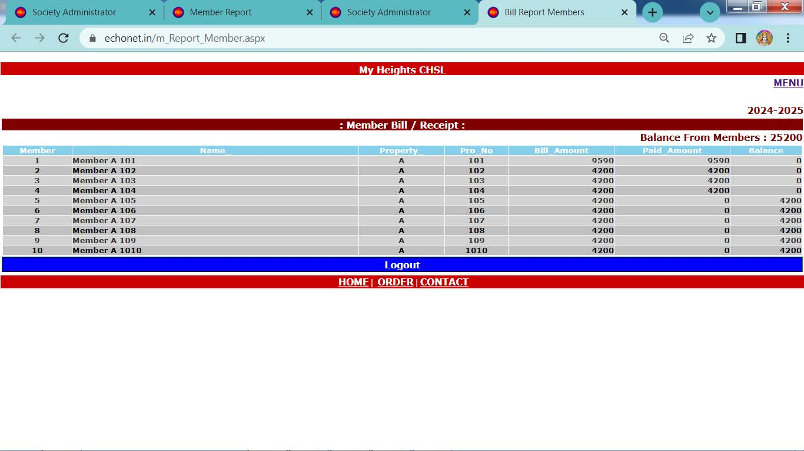
Member’s Bill / Received Report

Slide 41
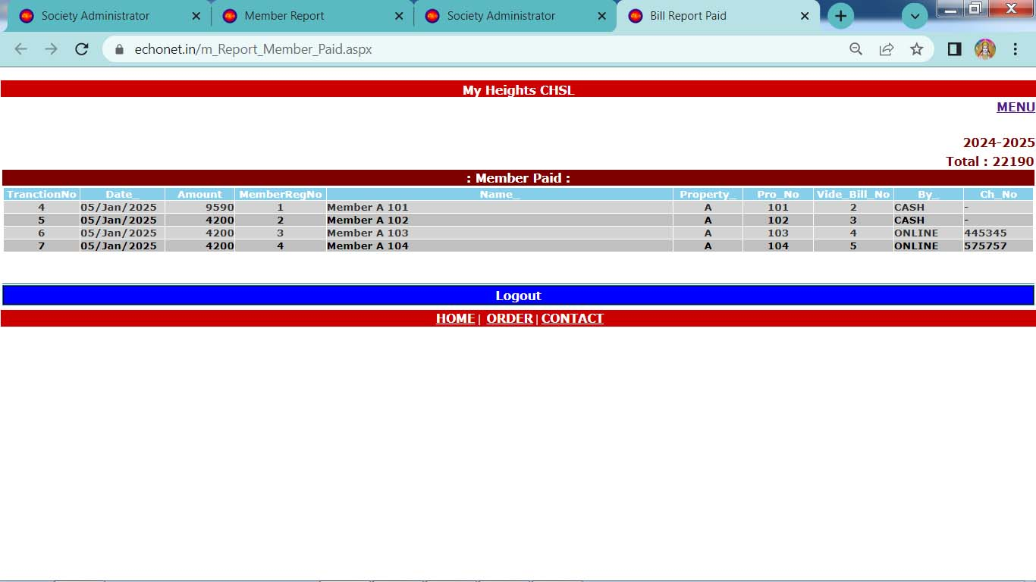
Received by Members

Slide 42
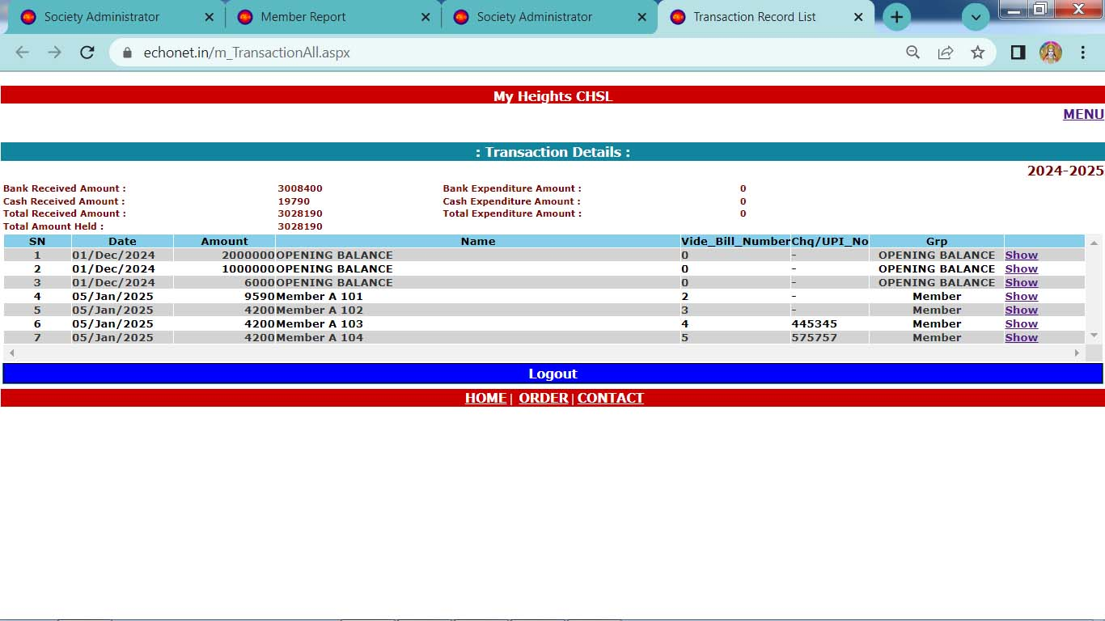
Transaction Reports

Slide 43
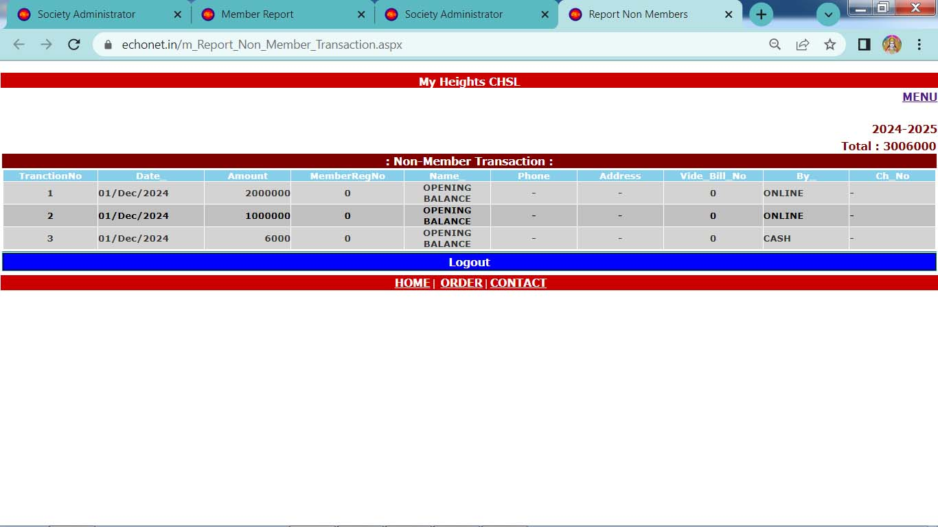
Non Member Transaction

Slide 44
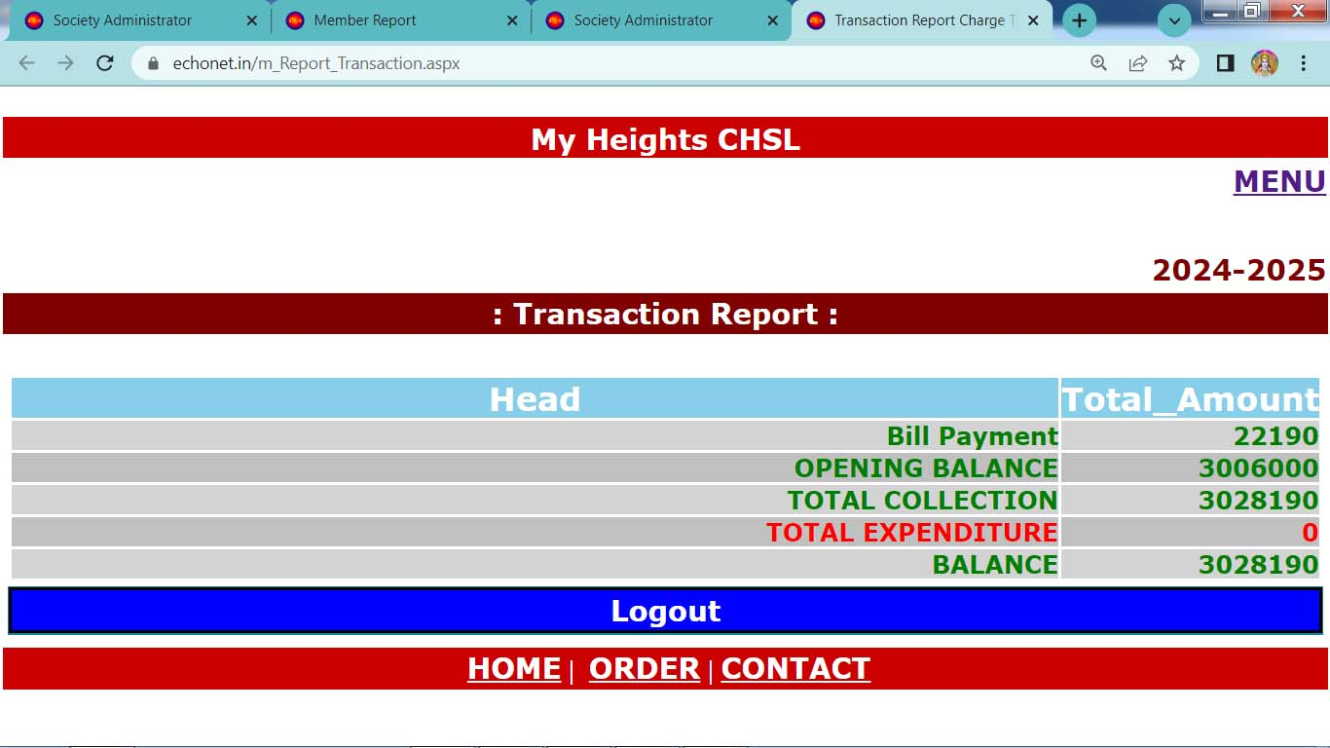
Transaction Report

Slide 45
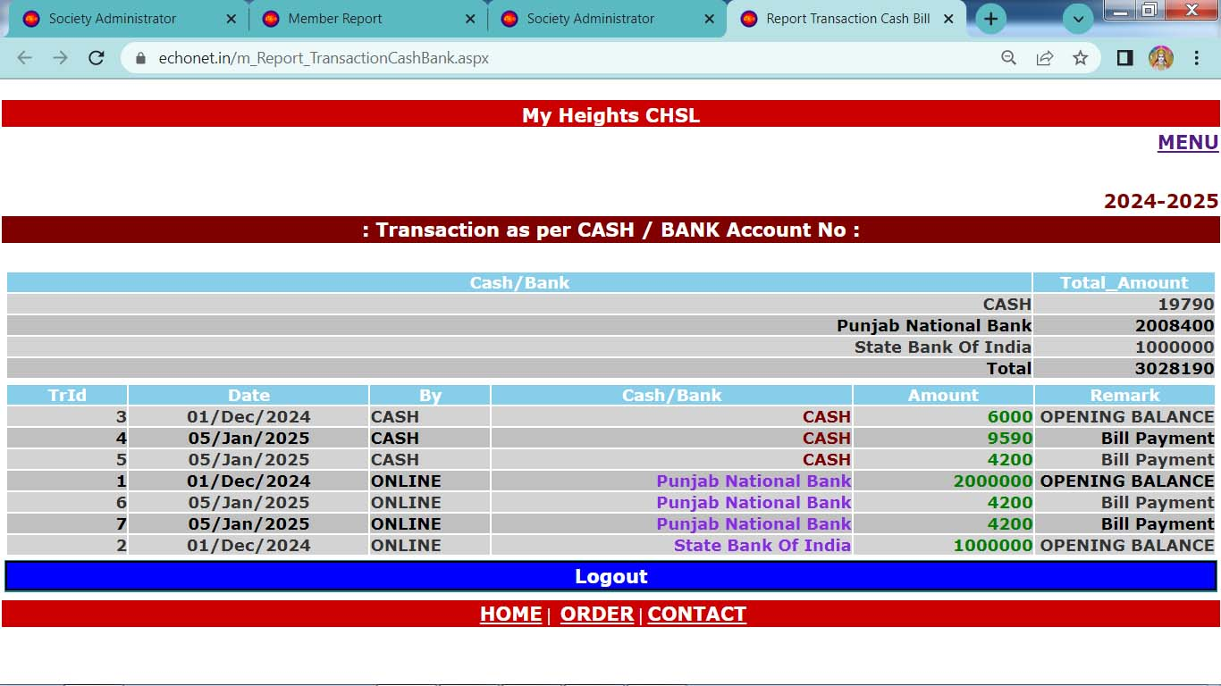
Transaction Report as Cash / Bank

Slide 46
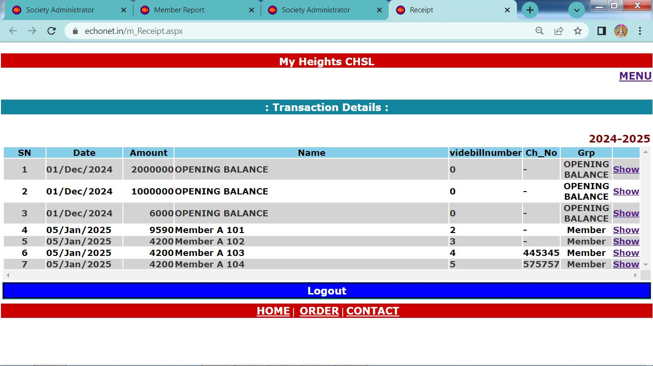
Transaction Details

Slide 47
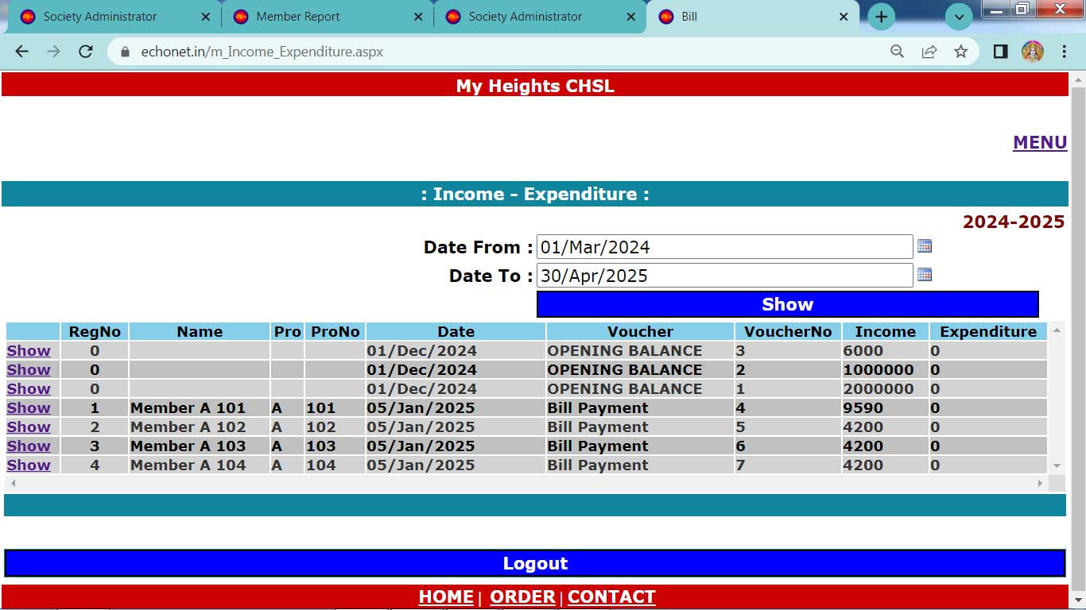
Income - Expenditure

Slide 48
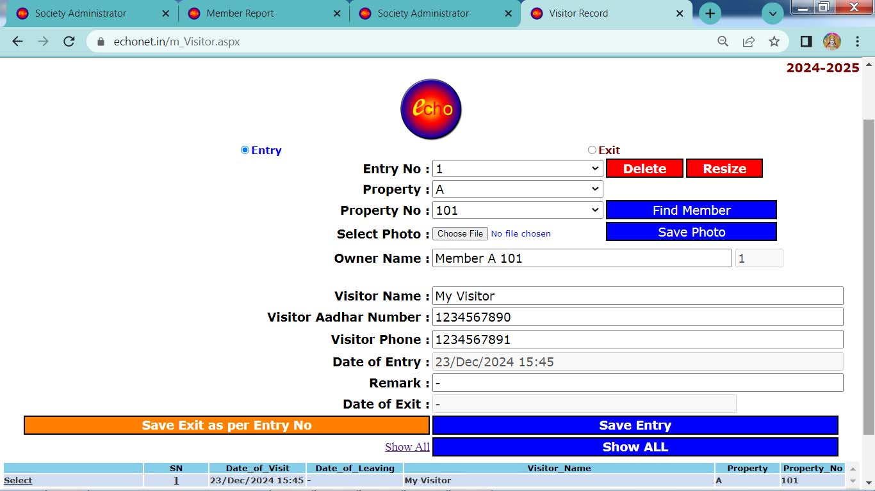
Visitor Record

Slide 49
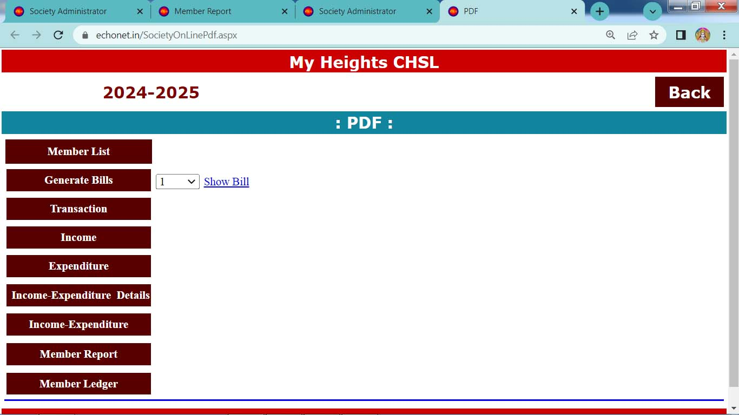
Generate PDF

Slide 50
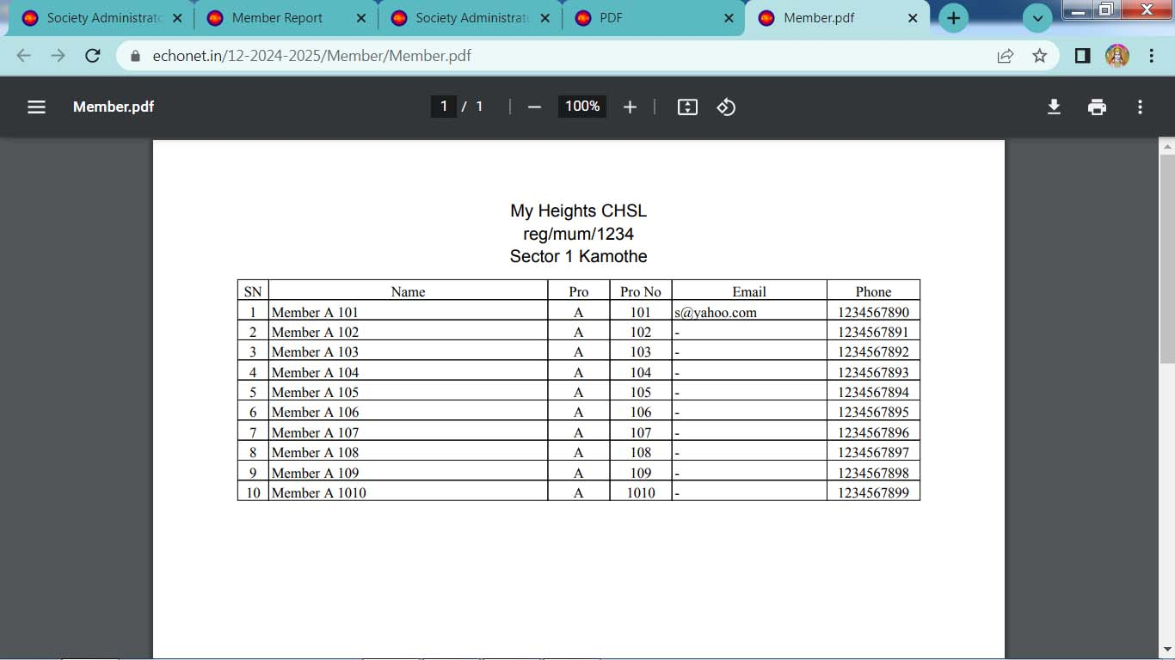
Member List (Pdf)

Slide 51
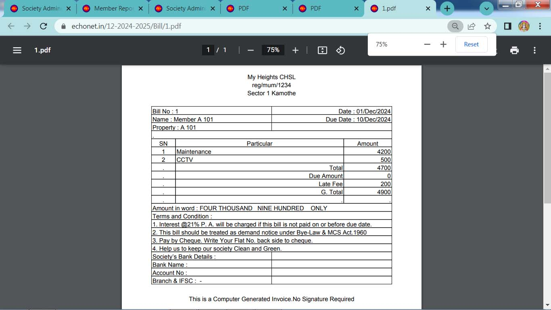
Bill (Pdf)

Slide 52
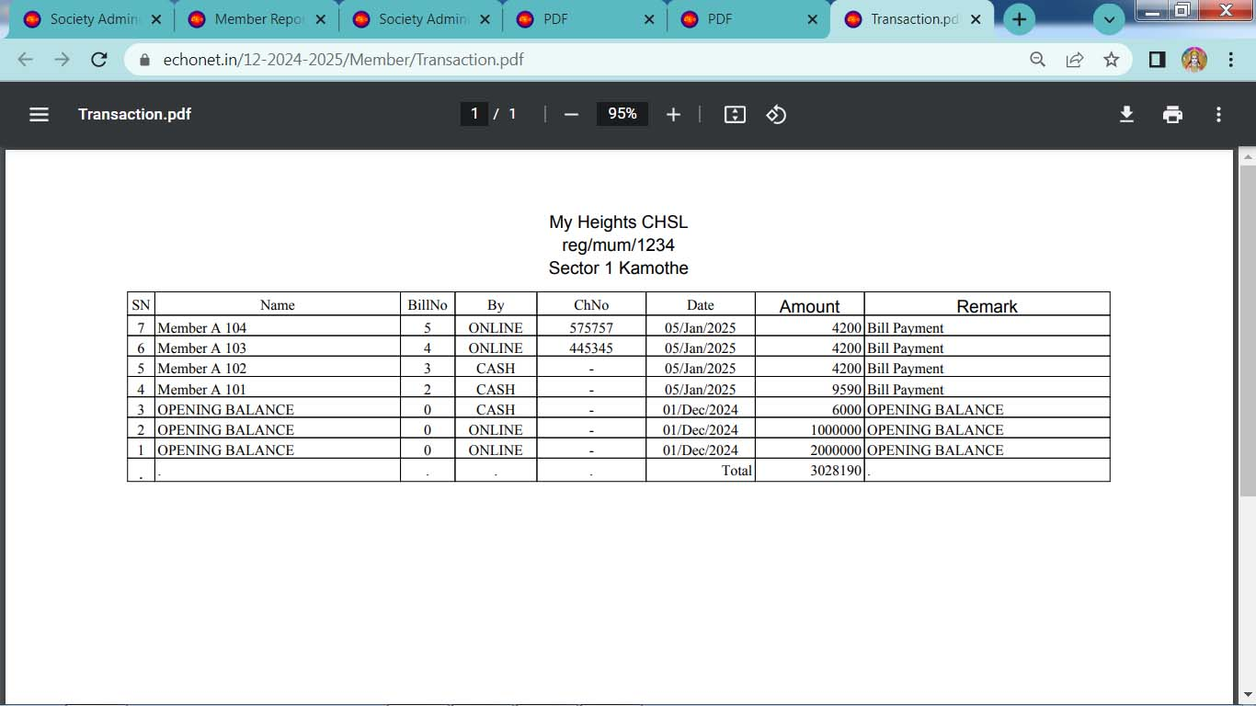
Transaction (Pdf)

Slide 53
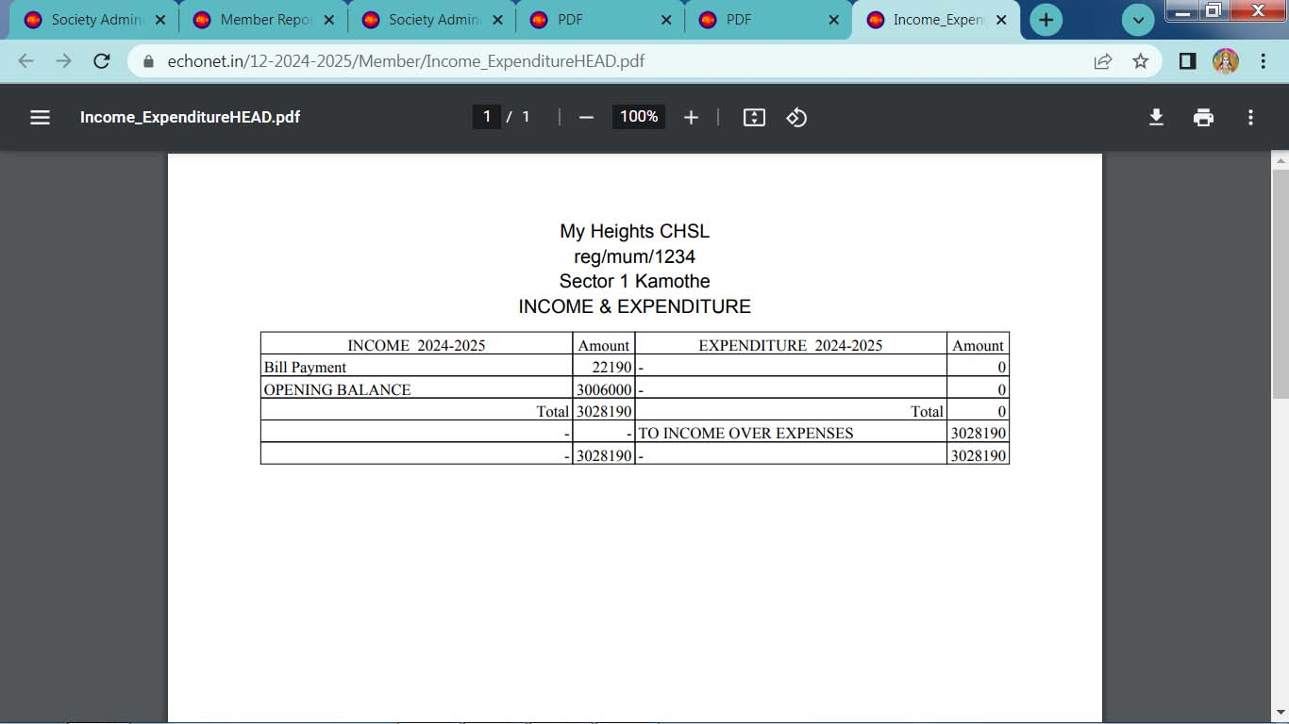
Income – Expenditure (Pdf)

Slide 54
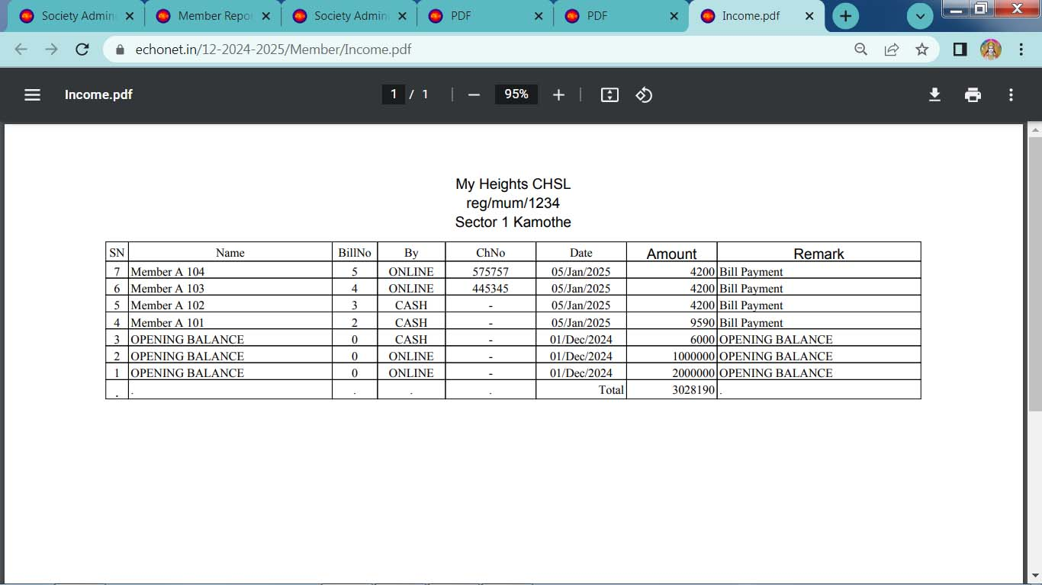
Transaction

Slide 55
Member Transaction Report

Slide 56
Member Transaction Report

Slide 57
Employee Database

